Slide 1
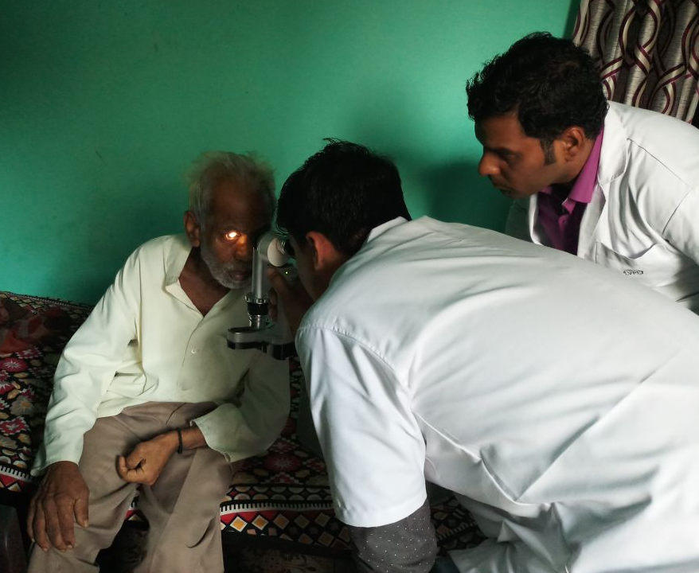
Why do people remain cataract blind despite easily accessible and affordable quality service? Patient's perspectives of barriers to cataract surgery in a four-year prospective study in Pune Slums
Parikshit Gogate, Supriya Phadke, Shravani Gogate, Rajiv Khandekar, Geeta S Pardeshi
Dr. Gogate’s Eye Clinic, Community Eye Care Foundation.
Abstract:
Flow of patients in the study
Aims: To understand why patients do not undergo cataract surgery despite the availability of services in the vicinity
Settings: Low-income group settlement
Design: Prospective community-based study
Methods: A door-to-door eye screening was conducted in 2015-16with a vision center offering subsidized care. Those detected as having operable cataracts were advised surgery. On follow-up visits in 2017, 2018, and 2019, those still visually impaired with unoperated cataracts were interviewed( questionnaire-based) to identify barriers to cataract surgery.
Results: We screened 45,535 persons in 2015 -16. After one year, 474 were still blind with cataracts. Of them, 85 (25.8%) had undergone cataract surgery in 2018, 245 still had cataracts. In 2019, of the 245 participants, 47 (24.7%) had undergone surgery, and 143 remained. The main barrier was high cost (>50%) in all three years, especially in the older respondents (2017 and 2018: p=0.006; 2019: p=0.01). The other barriers were family/business obligations, and participants did not perceive cataracts as a severe problem ,was barrier significantly more in males (p=0.039) and those with longer duration of cataracts (p<0.001). The respondents with poor vision in the better eye had a lower rate of family obligations as a barrier in all years (2017: p=0.008;2018: p=0.013;2019 p,0.001).
Conclusion: The community screening and vision center addressed barriers like lack of awareness, service and distance , even subsidized cost was a challenge. Family/business obligations and no prioritization were other common reasons for not undergoing surgery. Qualitative research is needed to understand the dynamics of these barriers and design appropriate interventions.
Figure 1: The number and status of participants recruited at baseline and retained at each year of follow up
Individuals examined in 2015-16
45,535 Cataracts detected by CHW
Bilateral = 734, Unilateral = 535
Confirmed by optometrist: Bilateral 599, Unilateral = 208
In 2019: 47 had undergone surgery 143 still had cataract. Barrier questionnaire administered Died 18 Lost to follow-up 37
In 2018: 85 had undergone surgery 245 still had cataract. Barrier questionnaire administered Of them
wearing spectacles 49 Died 4 Lost to follow-up 137
Still found cataract visually impaired (<6/18) in2017
474. Barrier questionnaire administered
Table 1: Barriers to accessing cataract surgery reported by the study participants at each follow-up period
Barrier | Year 2017 N=474 n (%) | Year 2018 N=245 n (%) | Year 2019 N=143 n (%)
Do not have money to pay for eye checkup/surgery | 272 (57.4) | 138 (56.3) | 78 (54.5)
Family/harvest/business obligations | 188 (39.7) | 110 (44.9) | 73 (51)
Do not have a serious problem | 139 (29.3) | 73 (29.8) | 43 (30.1)
Able to see adequately | 89 (18.8) | 46 (18.7) | 23 (16.1)
Eye disease/decrease in vision are natural with growing old, and so do not need treatment | 55(11.6) | 33(13.5) | 19 (13.3)
Eye checkups are not a priority because of other health problems | 60 (12.7) | 29 (11.8) | 12 (8.4)
Afraid that seeing someone for an eye checkup would reveal vision loss, and therefore cause worry | 48 (10.1) | 29 (11.8) | 15 (10.5)
The dominant person in the family did not feel the need to seek healthcare | 20 (4.2) | 14 (6.7) | 7 (4.9)
Do not feel comfortable with the eye doctor/general medical practitioner that I have access to | 8(1.7) | 4(1.6) | 3(2.1)
Have to travel far for eye checkup | 15 (3.2) | 9 (3.7) | 4 (2.8)
Would like eye checkup but other medical problems prevent me from going | 30 (6.3) | 14 (6.7) | 6 (4.2)
Do not know where to go for eye checkup | 11(2.3) | 7(2.9) | 4(2.8)
No one willing to escort for the eye checkup | 10 (2.1) | 5(2) | 3(2.1)
Others - wanted free surgery | 141 (29.8) | 73 (29.8) | 49 (34.3)
Data of Door to Door Survey
Total household | 9463
Total screen | 44535
Cataract | 565+788
Refractive error | 3503
Table 2: Comparison of barriers to cataract surgery in recent years across the world.
Methodology
AUTHOR | COUNTRY | YEAR | POPULATION | MAIN BARRIER
Lange N | Poland | 2023 | Nation wide | Cost of medicines for surgery a barrier, widowed, single more like to undergo surgery earlier
Omiya D | Nigeria | 2024 | South east Nigeria, RAAB | Gender is barrier, so is cost
Max | China | 2020 | Rural China | Better vision
Awed AA | USA | 2023 | Nation wide | Those with higher income and insurance more likely to undergo cataract surgery
Yap if | Malaysia | 2022 | Nation wide | Need not felt 43.5% Fear/poor result of surgery 16.2%. Reluctance for surgery more outside central zone
Alsawahili H | Egypt | 2020 | Sohag governorate, RAAB | Cost 51.5%
ChariwalaR | India | 2021 | Tribal belt of Gujarat, RAAB | Lack of escort 34.3%
Shen W | China | 2020 | Yunaan minority study | Lack of awareness, knowledge, cost fear
Study was approved by institutional ethics sub-committee of Padmashri D. Y. Patil Medical College, Pimpri, Pune, India.
Study was conducted in two sections:
PART 1 Six -subsection
Identification
Vision testing and lens status
Reasons for not having surgery
Service indicators for those operated, and
Anecdotal information from the relatives if the person concerned was not present during the visit.
To fill up questionnaire after examination.
Strength
PART 2: Three subsections
Counseling was done in groups of 3 to 5
Patients were revisited by health care workers after 6 months of first counseling
To find out who were still not operated (one, two & three years later)& reason was again probed
This was a community-based study. The questions were asked in peoples’ homes or courtyards, not when they visited the health centres. For the first time, we have barriers being considered not as a snapshot but over the years.
Acknowledgement
Dr. Taraprasad Das for his guidance
Dr Shrivallabh Sane for Biostatistics
Optom Mohankumar for editing poster
26th ISGEO Congress, Kathmandu, Nepal

